Slide 1


SAFETY BOX CONTROL PANEL - Hang Seng Bank

Slide 2
We
Are
...
Law Hong Chun Zachary
56237888
Develop Product (workable system/prototype with test data)
Frontend & Backend
Specifications
ER Diagram
Data validation
Chen Tak Hei Rex
56226087
Professional Aspects & Ethical Issues
Ethical manner, new & difficult skills/tools learned & applied
Quality, appropriate design, technically sound implementation
Primary testing
Lai Justine 56235545
Objectives, Gantt chart & deliverables
Methods, tools & platforms
Use Case Diagrams, Sequence Diagrams
Secondary testing
Chan Yik Kit Amy
56237852
Business case (including a model of the target operations) & Budget sheet
Activity Diagrams, Class Diagram/E-R diagram
User operation guide (Install guide/User Manual)
Secondary testing
Tsang Yung Rosita
56273550
Meeting objectives, workable solution (model/system)
User requirements fulfillment & deliverables accomplishment
Academic challenge (depth, scope, difficulty), appropriate analysis approach & methods
Secondary testing
Martinez Kiel Marc
57162491
Project Background
Work Breakdown Sheet(WBS) & Scope
Project Log & schedule, Team member & responsibilities
Secondary Testing

Slide 3

Contents
Background
Key features
Project Management: Business Case
Estimated Budget Plan
Target Operation Model (TOM)
WBS
Journey to Containerization
IBM Garage Method for Cloud
Migrate and Modernize using the IBM Garage methodology – Containerization
IBM offerings for Containerization
Offering overview – objectives and features
Tools and technology
IBM differentiators
Next steps

Slide 4
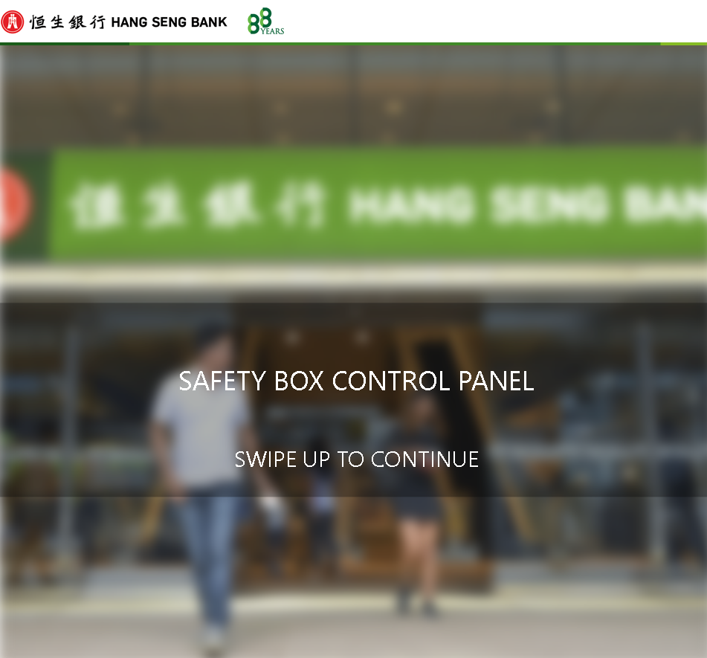
Background
Notes:
Hang Seng Bank background: - One of the most successful bank franchise and companies in Hong Kong - One of their most prominent service is the Safety Box: which allows clients to store valuables in a secure and reliable place (the Hang Seng Bank Vaults) - issues commonly found: -no knowledge of availability/ location of availability -old logging system of accessibility to the vault and safes - Looking to expand their success - by taking the safety box into the digital world and expanding on their strengths. While tackling vulnerabilities of the old system

Slide 5
Objective
Develop computer application
Check & registration
Notes:
The objective of developing the computer application of the safety box control panel is to improve its security and quality. Also, it will be more convenience for the staff and clients. The computer application can let them don't need to go to the bank in person.
The staff can help clients do registration, and clients can access after verifying their identity.

Slide 6
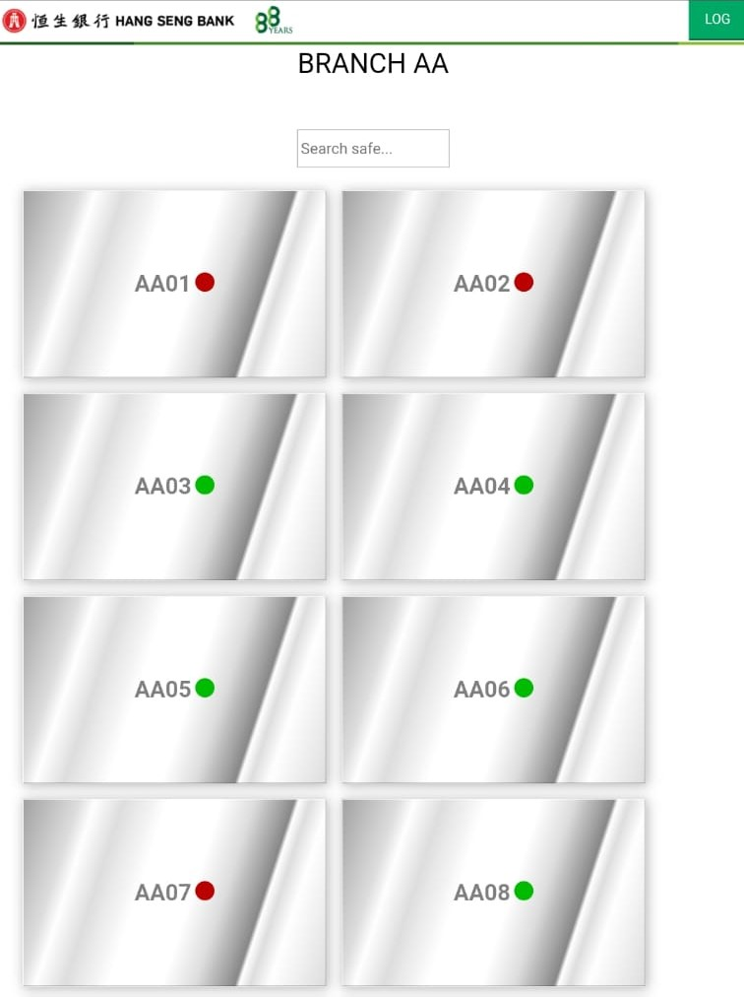
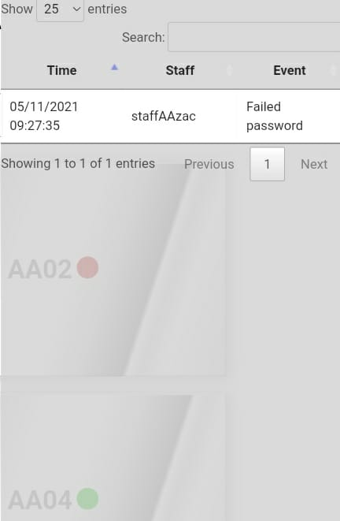
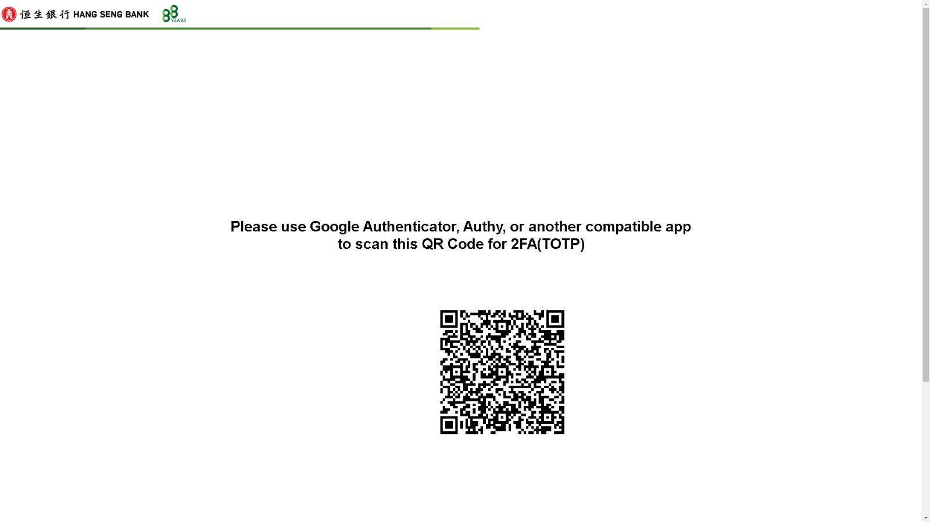
What is the
Hang Seng Bank -
Safety Box
Control Panel?
Key features:
Safety box selection
Safety box status display (Occupied/Available/Processing)
Registration
Verification
Audit log
CCTV Snapshot

Slide 7
Project Scope
Project planning
Costs
Goals
Deadlines
Overall, planning phase of the project, preparations, legal matters, SCOPE report, etc.
Business case and cost management: salaries, money dispersion, profit predictions, etc.
Goals, Milestones and objectives to ensure the progression of the project.
A date to meet to show progression to the sponsor/ client.
Safety Box Control-Panel
Hang Seng Bank
Notes:
Amy: Our strategy is to develop a useful computer application – control panel enhances the safety box service qualities of Hang Seng Bank in Hong Kong. The control panel will ensure all services, functions, and support the daily records of the safety box efficiently. It will also ensure that the panel is worked with accurately, functional, securely, and stable. These facts align this project to the bank strategy.

Slide 8

Project Management

Slide 9

Business Case
Project Name: Safety Box Computer Application (Control Panel) of Heng Seng Bank
Project Sponsor: Heng Seng Bank
Project Manager: Zachary Law
Date of Project Approval and Last Revision: 1st January 2022, 1st December 2022
Contribution to Business Strategy: A Useful computer application – control panel
Ensure all services, functions, and support the daily records
Accurately, Functional, Securely, and Stable
Notes:
Amy: Our strategy is to develop a useful computer application – control panel enhances the safety box service qualities of Hang Seng Bank in Hong Kong. The control panel will ensure all services, functions, and support the daily records of the safety box efficiently. It will also ensure that the panel is worked with accurately, functional, securely, and stable. These facts align this project to the bank strategy.

Slide 10

Business Case
Options Considered - Options considered included:
1. Creating a database to manage safety box status and data instead of human input and regular checking
2. Automatically generate notices of the real-time situation and status reports of safety box
3. Developing a control panel for safety box in each bank (divided by branch which provides safety box services)
Benefits:
1. Higher service quality
2. Increased client flow
3. Increased sales
4. Widen market
5. Better customer experience
Timescales
Initial analysis shows that the system will take approximately a year to implement and approximately a month for project preparation.
Notes:
1. Higher service quality - we estimate the bank can provide a more innovative and efficient service to the client
2. Increased client flow - we estimated we lose quite a part of all clients in need of safety box service due to current issues currently
3. Increased sales - more efficient work steps refill the lack of employee and less time cost which may grow at least 5% sales
4. Widen market - more innovative service may attract new and important clients joining the bank
5. Better customer experience - better customer satisfaction and more convenient service experience will increase at least 25% through the new computer application of the safety box.

Slide 11

Cost & Budget
Expected Return on Investment
Year 1 = $0
2nd Year = $500,000
as control panel begins to be felt and application implemented.
3rd Year = $1,000,000
as the control panel begins to be felt and revised with maintenance.
Risk --->work closely with the development team.
Cost
Application (Control Panel) development | = $600,000
Project Management | = $200,000
Develop team | = $300,000
Consultant from Bank | = $0
Testing | = $50,000
Computers and tools | = $150,000
Administrative costs | = $100,000
Total estimated cost = $1,400,000
Notes:
Amy: Risk - The project appears to be quite basic at the moment, however, there are some unknown implementations. There is also a chance that the application and revisions will not fulfil the demands of the product provider or the customers. Therefore, it needs to work closely with the development team.

Slide 12
Cost & Budget
1 year project (HKD)
i. Assume 20 man-days per month
ii. One full time PM = $1,200 per man-day
iii. One full time Junior PM = $800 per man-day
iv. 4 full time programmers at $500 per man-day
v. Training & support (duration 150 man-days) at $300 per man-day
vi. 4 Testing costs each at $25,000
vii. 5 Laptops each at $10,000
viii. 2 printers each at $10,000
ix. One part time (50%) accountant = $500 per man-day
x. Reserve = 10% of total budget estimate
xi. Administrative costs = $1,000 per man-day
xii. Domain fee subscribed $500 per month

Slide 13

Cost & Budget
1 Year Project (HKD) | Duration (man-days) / Units | Cost per man-day / Cost per unit | Total
a) Subtotal - WBS Activities | 1,470 | 4,800 | 1,065,000
b) Subtotal - Facilities | 11 | 45,000 | 170,000
c) Total (a + b) | 1,481 | 49,800 | 1,235,000
d) Reserve (10%) | 123,500
TOTALS (c + d) | 1,358,500 (< 1.4M)
Notes:
Amy: 1M&65K 170K 1M&235K

Slide 14
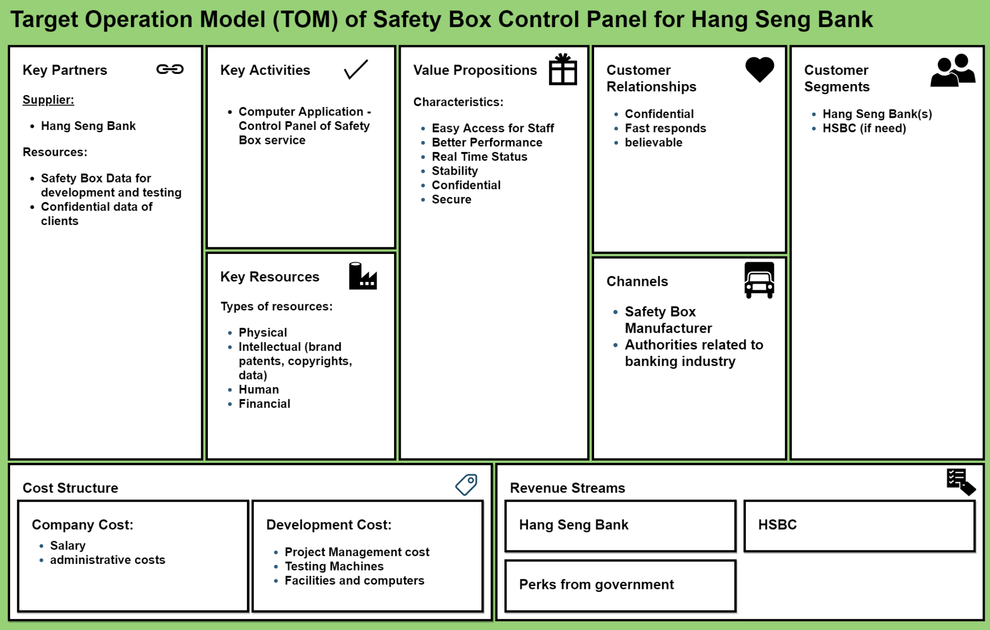

Slide 15
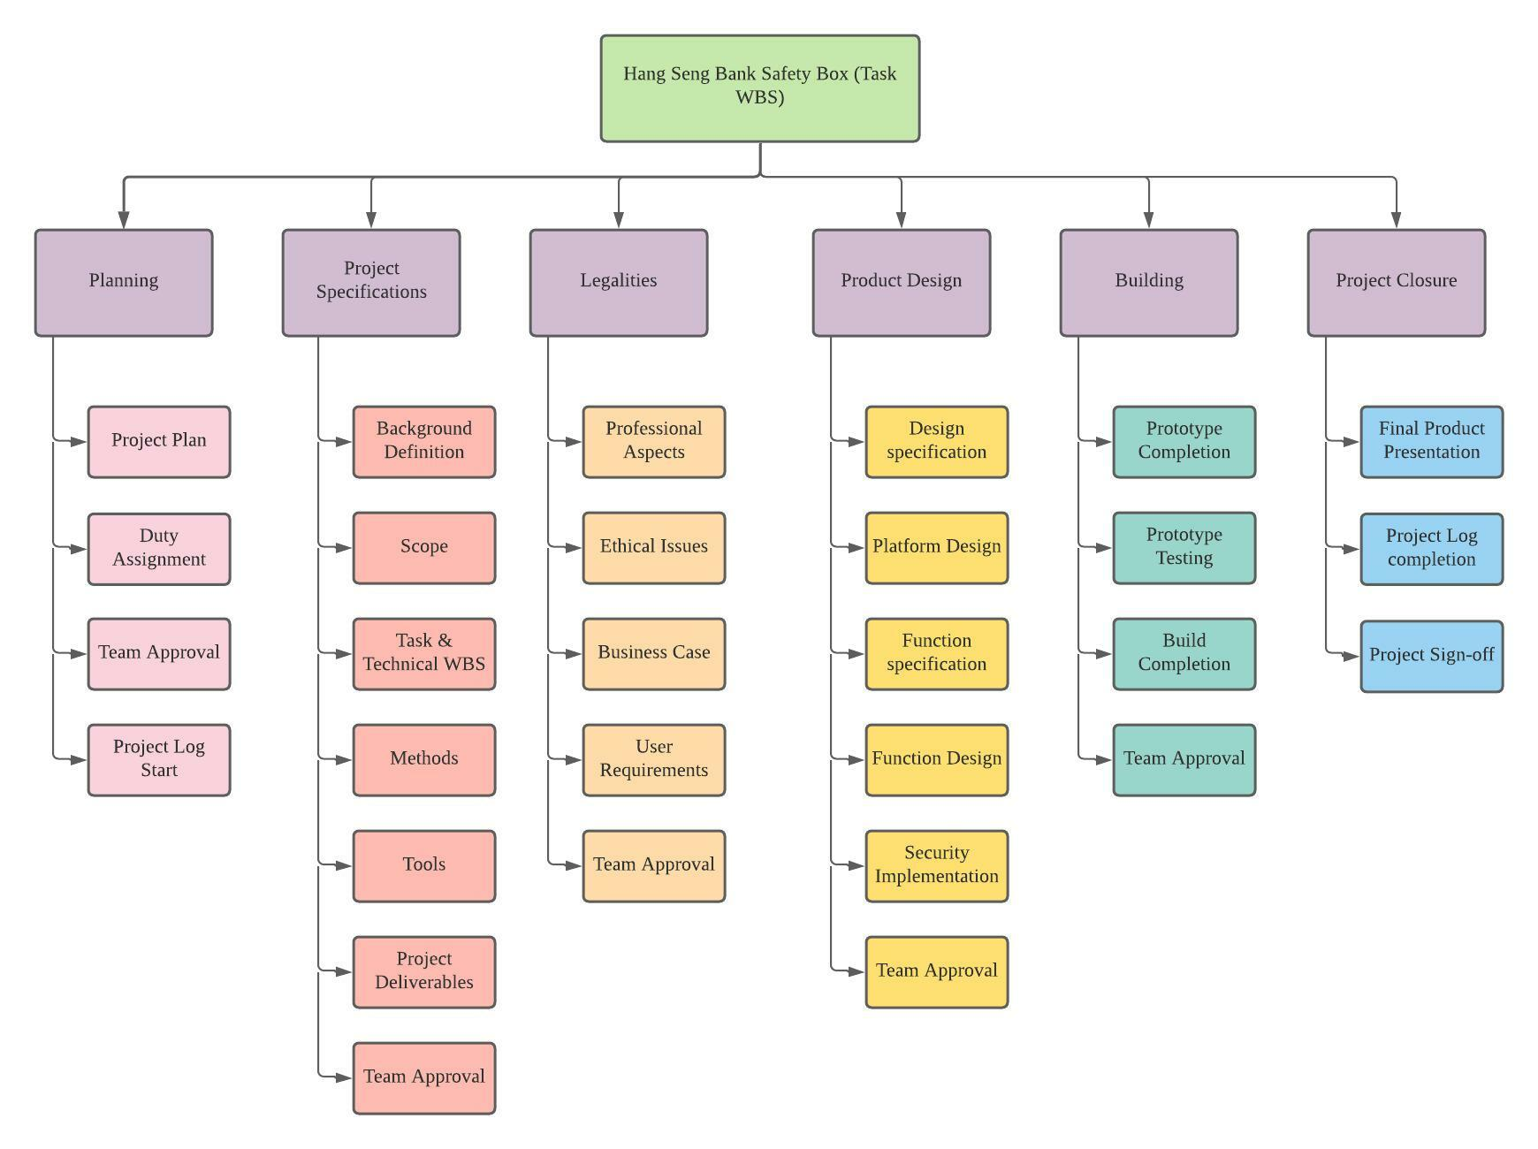
Work
Breakdown
Structure
A blueprint to guide the project to completion
Divided into multiple phases with different focuses
To keep work consistent and on track

Slide 16
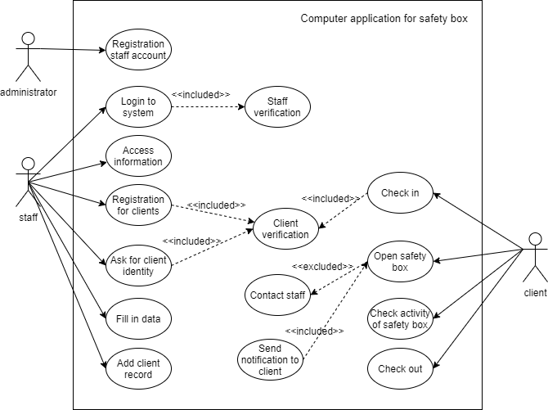
Use Case
Diagram
Notes:
A use case diagram is a graphical depiction of a user’s possible interaction with a system. The administrator will register account for staff. And the staff can login to the system with the verification. After logining in, staff can access the information

Slide 17
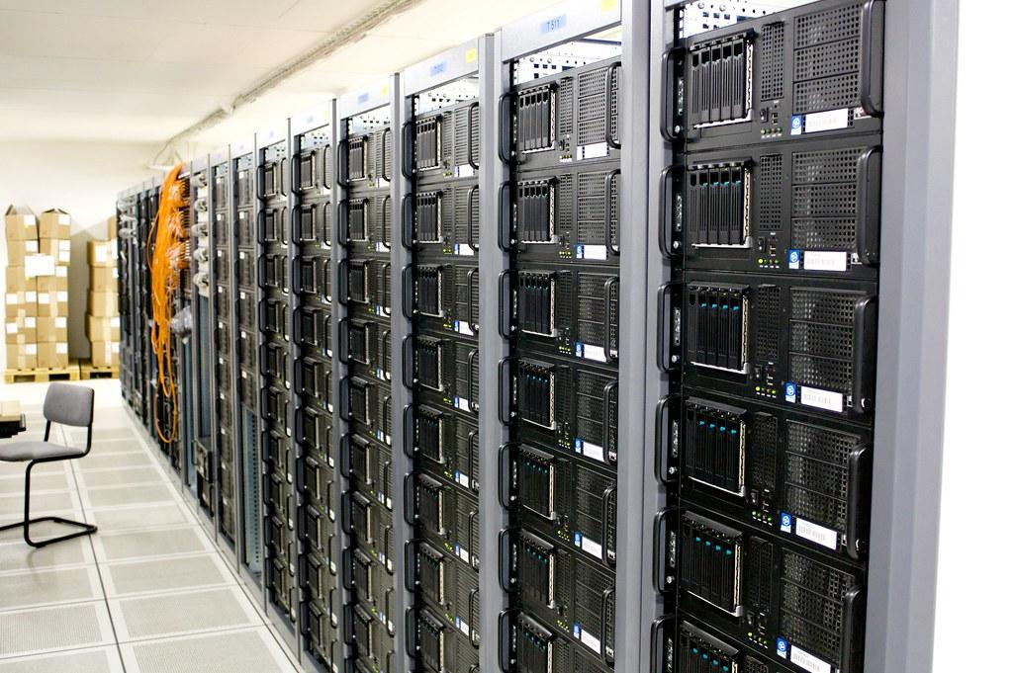
Project Computer System Deliverables

Slide 18




Project Objective
Staff login
Verify staff for safety purposes
Need access rights
Staff registration only by administrators
Registration
Registration for new clients
Add client records
Staff registration only by administrators
Verification
Verify the client's identity
Audit log
Every move will be recorded
Administrators can review the log

Slide 19
Deliverables accomplishment
Staff login
Only access own branch
Need access rights
Registration
Simple form for staff to fill in
Client record will be added immediately
Unregistering a client will not delete ones data
Verification
Staff will be able to check the client info
Audit log
Every account movement will be recorded

Slide 20
Academic challenge
Scope
Challenge
For a safety box service computer application of a real bank, it should consist of multiple functions, a fully functional user interface, and a fully developed database with huge support.
Solution
Since the time is not enough for us to develop a complete functioning program, we decided to cut off most of the complicated functions and make a check-in check-out application with simple staff verification and client registration.
Development Expectations and Outcome
Challenge
The major reason for the complexity of the project is the constant changing of requirements.
Solution
To ensure that the product outcomes align with expectations and requirements, a solid process and line of communication need to be established.
Define and agree on the scope of the project
Communicate the needs and expectations between the development and ideation teams
Consider UX from the start of new product development
Create a clear, concise, and thorough requirements document and confirm your understanding of the requirements
Create a prototype to confirm and/or refine final agreed-upon requirements

Slide 21
Academic challenge
Quality Assurance
Challenge
Not reviewing code, or suppressing errors are just a means that developers use to save time and meet deadlines.
Solution
Following a formal quality assurance process is imperative for a successful launch.
Discourage developers to cut corners in the development process
Encourage them to use the best code development practices to meet the requirements sooner and more efficiently
Undefined Quality Standards
Challenge
Defect identification is inevitable during functionality testing, even if the product has been through thorough unit testing during the development phase.
Solution
When coming out with the test approach, scenarios, conditions, cases, and scripts, make sure the test plan covers all the requirements that are to be delivered by planning several cycles of testing.

Slide 22
Academic challenge
Adapting the Latest Market Trends
Challenge
Catering to the latest technology requirements is often challenging.
Solution
Make sure the resources constantly polish skills to remain relevant. This means staying up-to-date on market trends and exploring insights into the new technology and trends that are out there.
Design Influences
Challenge
Product designs are under constant influence from stakeholders, the development organization, and other internal and external factors. Managing these influences is essential for maximizing the quality of systems and their related influence on future business opportunities. The increase of easily accessible, simple applications has resulted in user expectations growing exponentially.
Solution
we make sure streamline our design and offer a consistent experience across devices, operating systems, and form factors.

Slide 23

Ethical
&
Professionalism
Issues

Slide 24


Ethical issues
Do the Moral Things
There are several things developers need to aware of, one of the things is our sense of professionalism and stay in an ethical lane.
Ethical issues
Professionalism
Organizations
Law From UK
Law From HK
ACM
Ordinance of Data Protection
BCM
IEEE
Data Protection 2018
Copyright Act 2000
Act of Freedom of Information use
6 Principles of Data Protection
Laws and crimes
Act of Freedom of Information use

Slide 25
Ethical issues
Do the Moral Things
Case Examples
There are several things developers need to aware of, one of the things is our sense of professionalism and stay in an ethical lane.
Ethical issues
Professionalism
Creating Backdoors
Developers should not do such things as it will affect their professionalism in a negative way. It is a standard of people should care about as data privacy is becoming more heat nowadays and they care about how people will use their personal data.
Collecting Data in an Unethical Way
Data collected use in other ways such as monetization
Developers and data clerk should obey the principles of data protection provided by the Hong Kong Ordinance of Data Protection. Including the Organizations should list a policy of how and why the data is being collected from Users and how they would use it, so people can always ask for the permission of what data is being collected to protect themselves.
Organizations should not use the data collected from consumers at other ways apart from the agreement of how the data collected will be used in previously. Such that consumers raise their awareness of the data usage of organizations, and loyalty of keep using the banking products will be decreased.

Slide 26

The Production

Slide 27
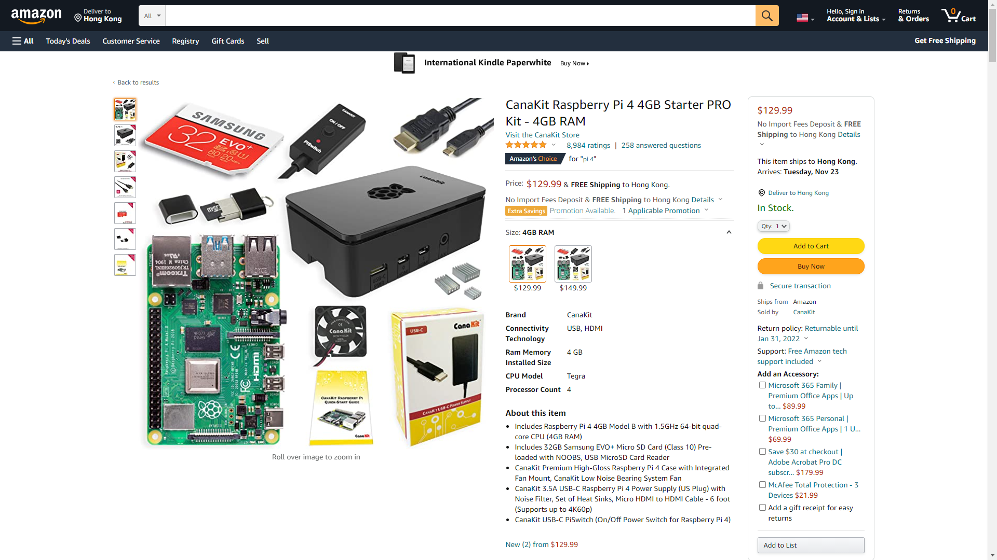
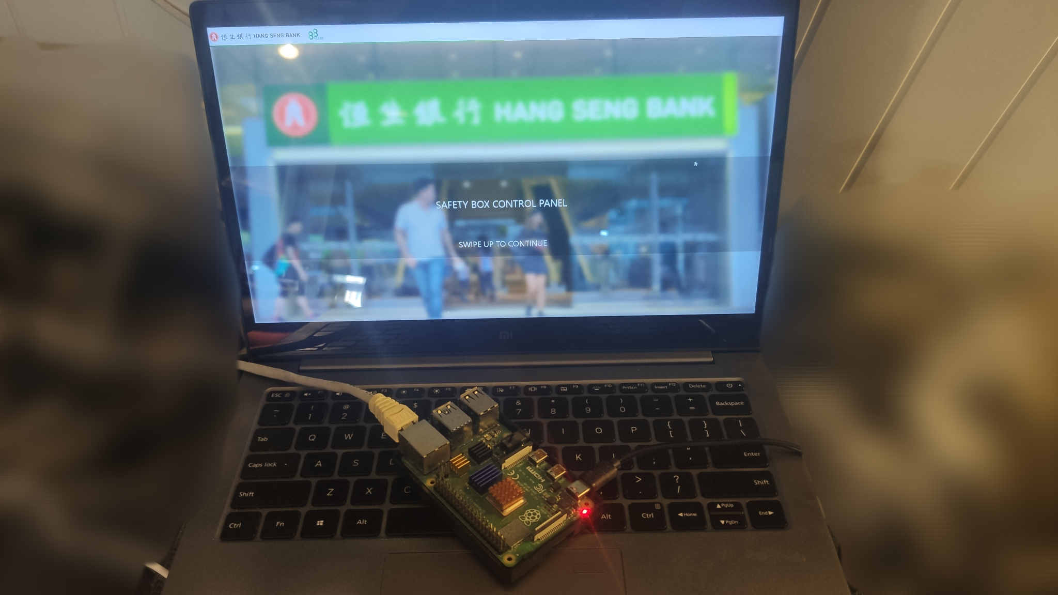

Specifications
Raspberry Pi 4 (Model B)
Extremely low power draw, small form factor, no noise, solid state storage, and other features make it an attractive solution for a small and lightweight server.

Slide 28
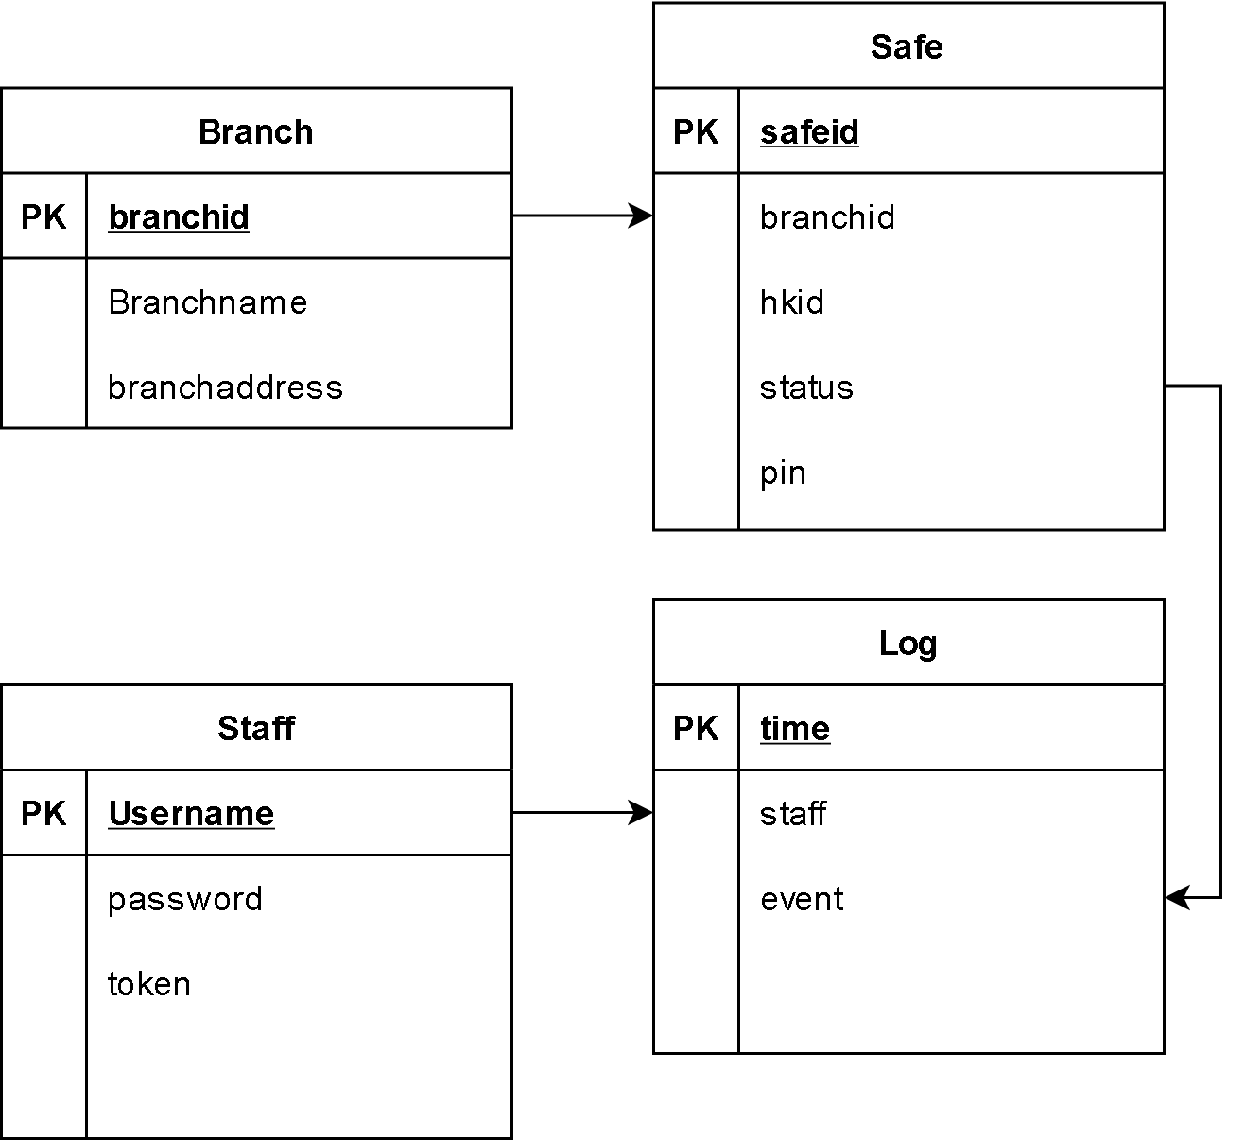
Entity Relationship Diagram

Slide 29

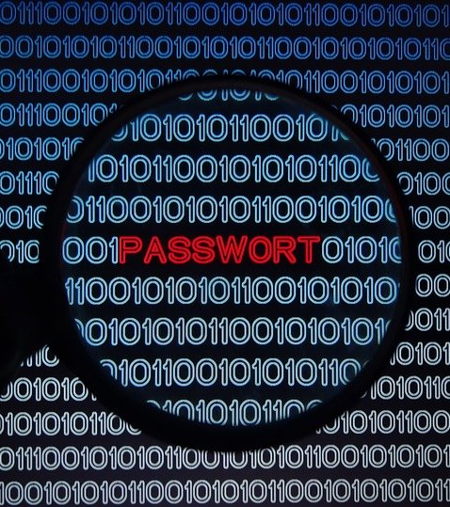

Specifications
Raspbian GNU/Linux 10 (buster)
Raspbian is a free operating system based on Debian optimized for the Raspberry Pi hardware
Python 3.9.7
Python is an interpreted high-level general-purpose programming language.
3.7 Flask
Flask is a micro web framework written in Python. Classified as a microframework.
1.0.2 Mod_WSGI
mod_wsgi is an Apache HTTP Server module by Graham Dumpleton that provides a WSGI compliant interface for hosting Python
based web applications under Apache.
PyOTP 2.6.0
PyOTP is a Python library for generating and verifying one-time passwords. It can be used to implement two-factor (2FA) or multi-factor (MFA) authentication methods in web applications
3.10.0 Sqlite3
SQLite is a C library that provides a lightweight disk-based database that doesn’t require a separate server process, allows accessing the database using a nonstandard variant of the SQL query language
0.0.78 Supersqlite
Intended to be a drop-in replacement to Python's built-in SQLite API
Notes:
global representantion

Slide 30
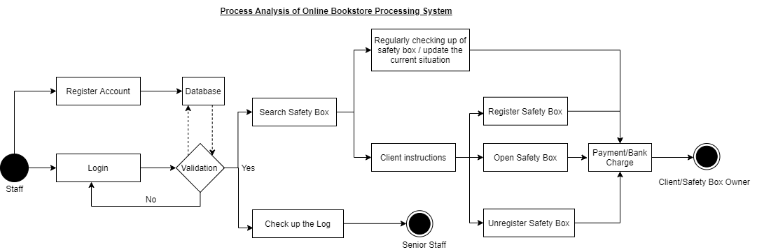
Activity Diagram

Slide 31
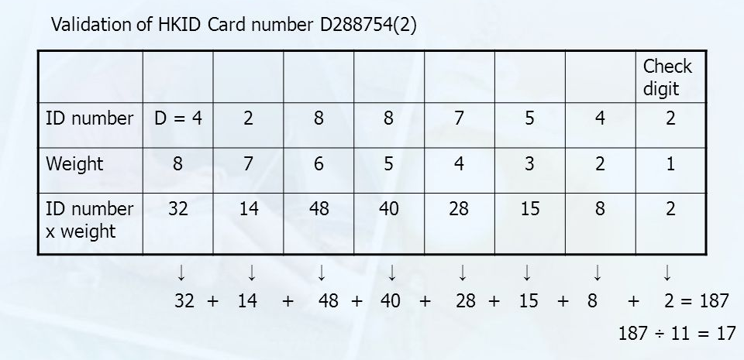
Data validation - HKID Check digit

Slide 32
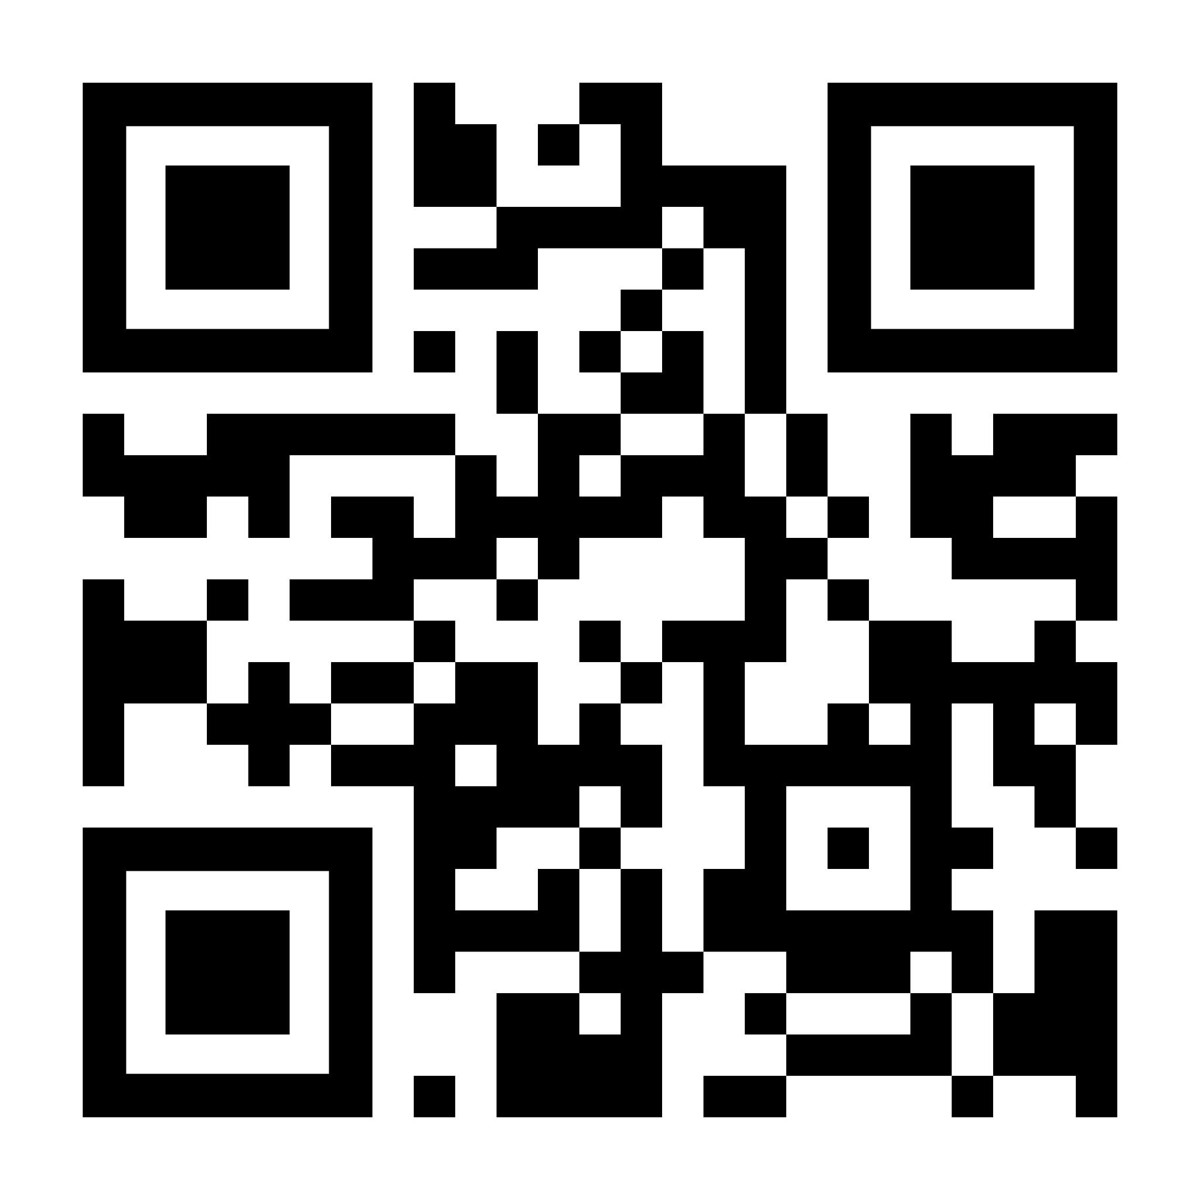
Live
Version
206hs.github.io

